Slide 1
Unsupervised learning, intro to NLP

Slide 2
When to use which model?
If your data is labelled, you can do supervised learning:
Deep learning: complex relationships, large datasets, tasks that resemble ImageNet classification or things other pre-trained models (BERT for NLP) can do well
Shallow learning: the simpler models we covered earlier in the semester
What about if your data in unlabelled?
Contrived example: you are a plan biologist taken to another planet, and your job is to come up with labels for all the different species of plants you have data on
More realistic example: you want to segment your customers into groups based on their shopping behavior
More realistic example: find (model) the topics your customers are discussing in your product reviews

Slide 3
Unsupervised learning
Our learning task is unsupervised if our data doesn’t have labels
Some common objectives we’ll cover here are:
Clustering
Topic modeling

Slide 4
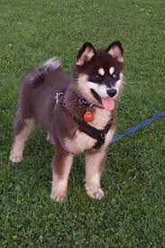
Clustering
Let’s try a hypothetical example together (even though we already know the answer)
Imagine I gave you 1000 images of different breeds of dogs, but you didn’t know what these breeds were, or even how many breeds there are
How would you start to cluster them?
Choose the feature that splits them most cleanly each time?
How would you refine your clustering?
Make an additional split when you look at the images and decide they need one
Maybe you initially grouped labradors and golden retrievers together, and later realized these can be meaningfully split
What if you have a dog that is a Pomeranian-Husky mix in your dataset?
What if you only had three images of a German Shepherd?

Slide 5
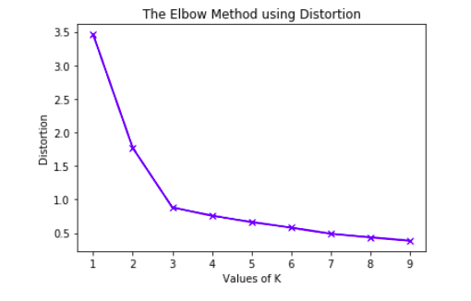
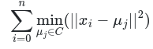
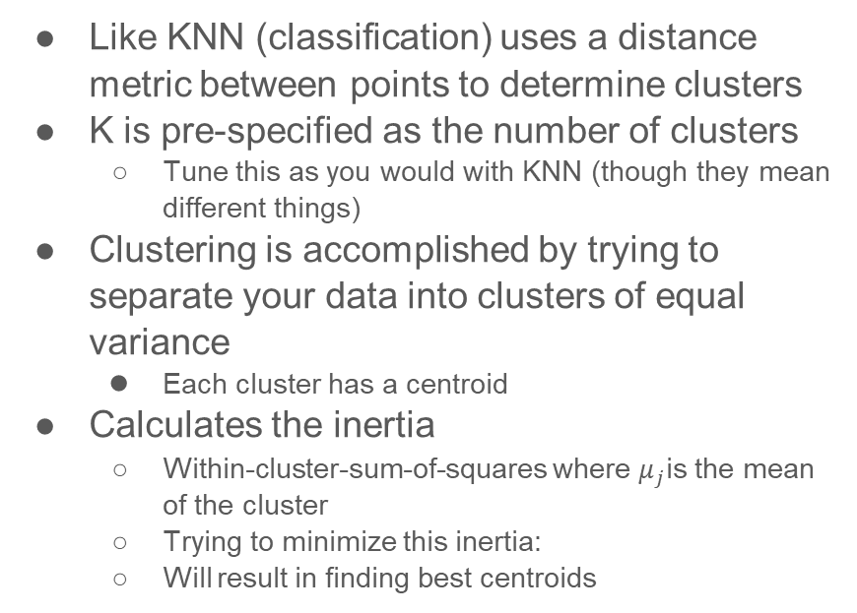
K-means clustering
Like KNN (classification) uses a distance metric between points to determine clusters
K is pre-specified as the number of clusters
Tune this as you would with KNN (though they mean different things)
Clustering is accomplished by trying to separate your data into clusters of equal variance
Each cluster has a centroid
Calculates the inertia
Within-cluster-sum-of-squares where $μ_{j}$is the mean of the cluster
Trying to minimize this inertia:
Will result in finding best centroids

Slide 6
K-means algorithm
Choose the initial cluster centroids
Simplest: pick k samples, or random points in space
Assign each sample to its nearest centroid (not a data point)
“Nearest” according to Euclidian distance, etc.
Recompute the centroids, by iterating through each current centroid and:
By taking the average of all the data points in the centroid -- this becomes the new centroid
Repeat steps 2-4 until convergence
Happens when clusters do not change
Note: features must be numeric, because we are taking averages
Nice explanation + video: https://www.youtube.com/watch?v=_aWzGGNrcic

Slide 7
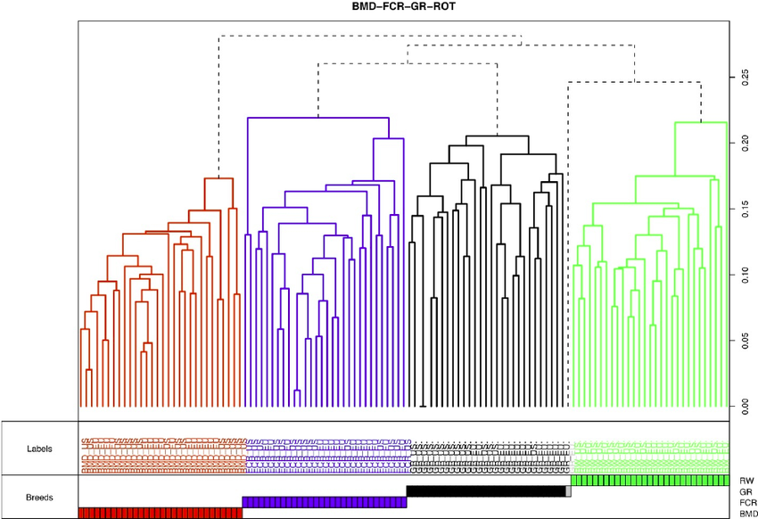
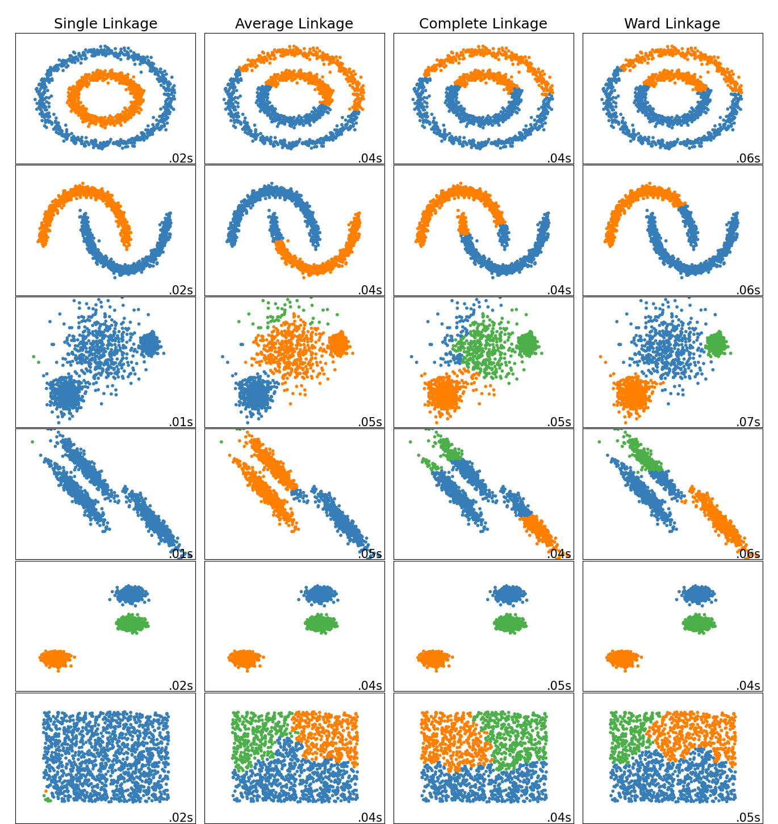
Hierarchical clustering
Image from Quignon et al. “Canine Population Structure: Assessment and Impact of Intra-Breed Stratification on SNP-Based Association Studies”
Agglomerative: performs bottom-up clustering using a chosen merging method
Left image from https://scikit-learn.org/stable/modules/clustering.html#hierarchical-clustering

Slide 8
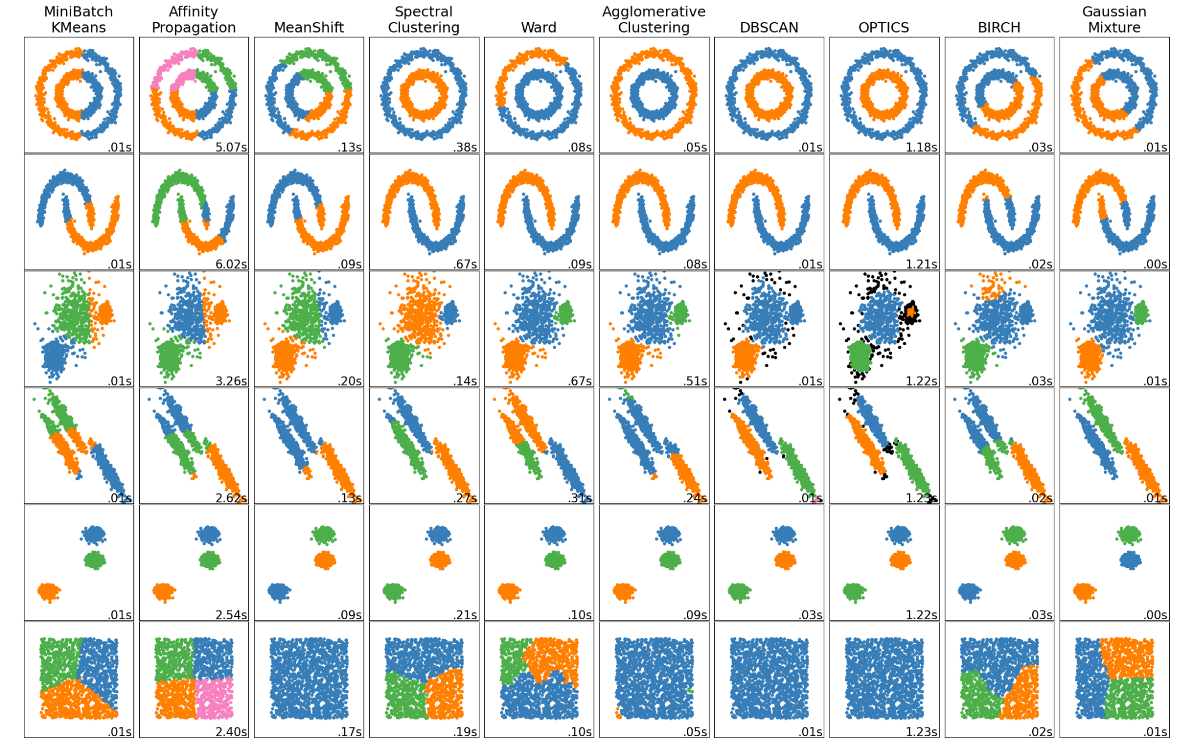
Choosing the right clustering algorithm
K-means is computationally simple!
But struggles with some distributions
Other algorithms exist (see right), but can take a really long time to run
Scikit has a nice summary of tradeoffs: https://scikit-learn.org/stable/modules/clustering.html#
Image at right is from that link

Slide 9
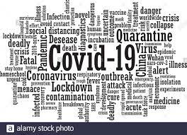
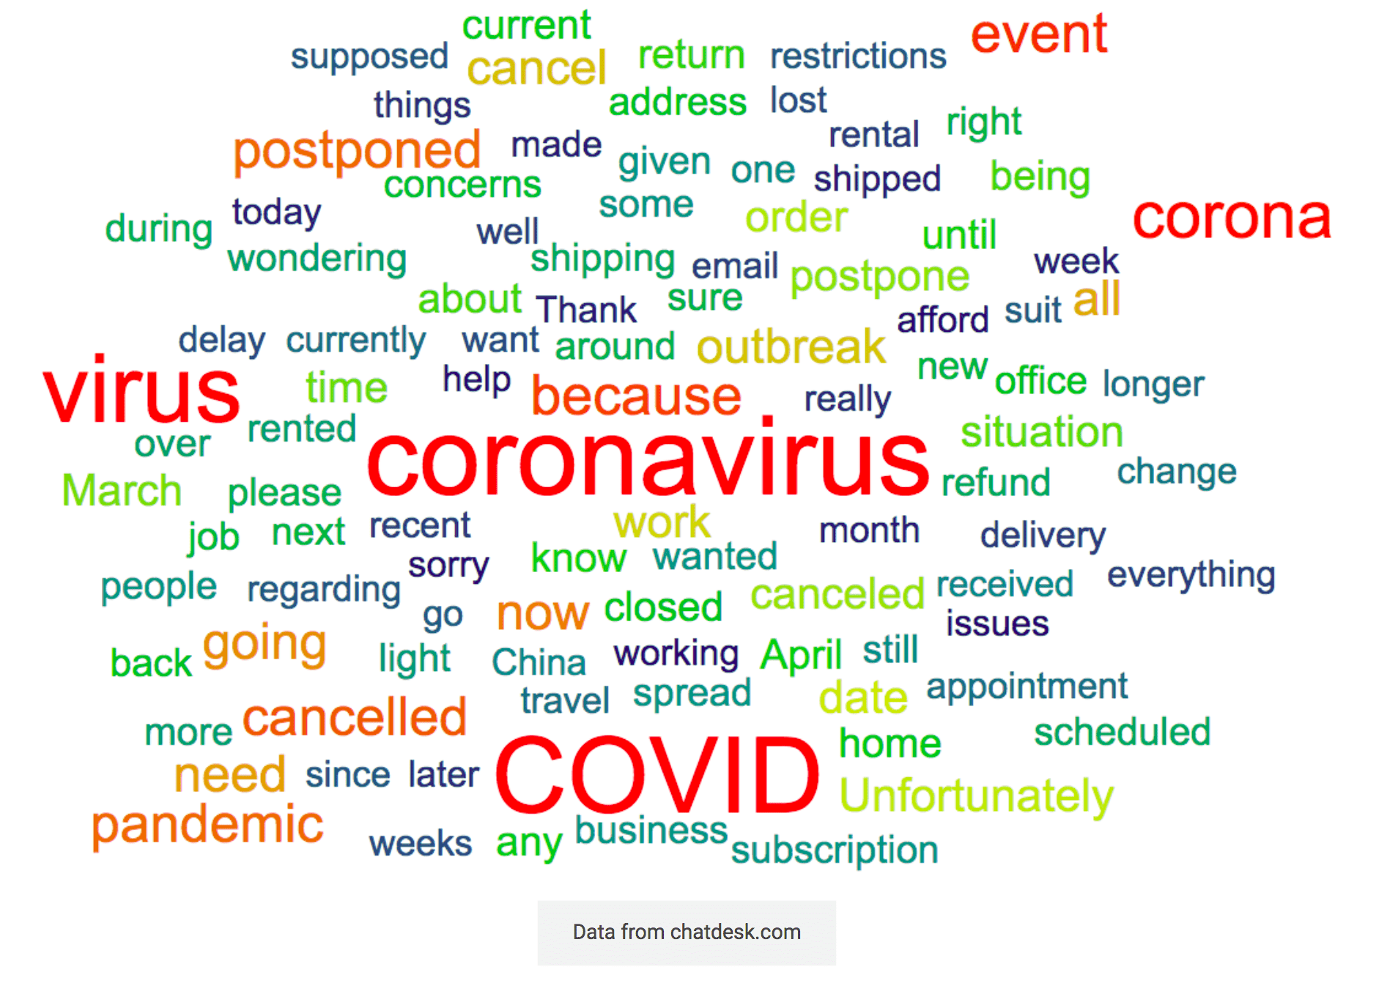
Unsupervised learning: Topic modeling of text
The old way (don’t put this on your resume):

Slide 10
Topic Modeling
You can make a ranked list of the most common words in your documents (the word cloud)
But there are arguably better ways to do this nowadays
Latent Dirichlet Allocation (LDA)
Specify the number of topics, K, you think might be in your corpora
Will return K topics based on the corpora, where each K is defined by a set of words
This means YOU have to interpret those words to deduce a topic yourself
Example topic from Amazon reviews -- what is it?
[('film', 0.029852536),
('movie', 0.010055234),
('films', 0.004800593),
('horror', 0.00475024),
('story', 0.0038416996),
('scene', 0.0034877707),
('action', 0.0033171456),
('like', 0.0032384025),
('dvd', 0.003099864),
('scenes', 0.0028694542)]

Slide 11
Our first foray into NLP
Natural language processing tasks typically involve more “prep” than just feeding an image (of pixels) into a CNN
Language has a temporal component
We won’t consider this for topic modeling here, but in general the better models take order into account
Often, we want to focus just on words (or even parts-of-speech) that we care about:
Use stopwords to remove common uninformative words like “a,” “the,” and “because”
Tokenize your sentences into words
Label/filter words by their parts-of-speech (POS)
Get the root of words
Find phrases to treat as words using n-grams
Once we’ve prepped the data, then we can do an analysis on the meaningful parts
Natural language follows rules
Natural language can be analyzed with probabilities

Slide 12
Some NLP use cases
Machine translation
Autocomplete
Voice recognition
Question-answering
Topic modeling
Summarization
Information Extraction
Text generation (GPT)
Autocorrect
“Understanding”
Spam detection
Chatbots
Urgency detection
Parts of Speech tagging
Named Entity Recognition
Entailment
Knowledge extraction
Confidence/tone analysis
Document Similarity
Claim matching
Plagiarism detection

Slide 13
More on Autocomplete/Autocorrect
Models are often trained to predict missing words to learn contextual representations of words, so this is a natural extension to that sort of thing

Slide 14
More on Machine Translation
Use a model like BERT (next class) to learn how to go from one language to another, between two sentences
These models allow us to predict missing words via context clues
Can also use a model to try to estimate the quality of the translation (regression)
Have seen some issues around bias of these models
Translating between a language that has no gendered pronouns to a language that does
You might hear people talking about “high resource languages” versus “low resource languages”

Slide 15
More on Question-Answering
You present a question, and it searches for meaningful answers
Different than a standard keyword search like Google
Although you can plug questions into Google…
How does it work? What can be learned by training a model with many question-answer pairs?
Current answer: it doesn’t work very well
It can answer factoids (What is the capital of the United States), but not all that much more than that
SQuAD training dataset: questions posed by crowdworkers on wikipedia articles, along with their answers

Slide 16
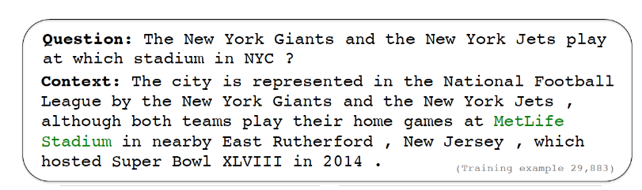
Example of a Question-Answer pair from SQuAd
Answer is always in a continuous span of the context
Most answers are less than four words long

Slide 17
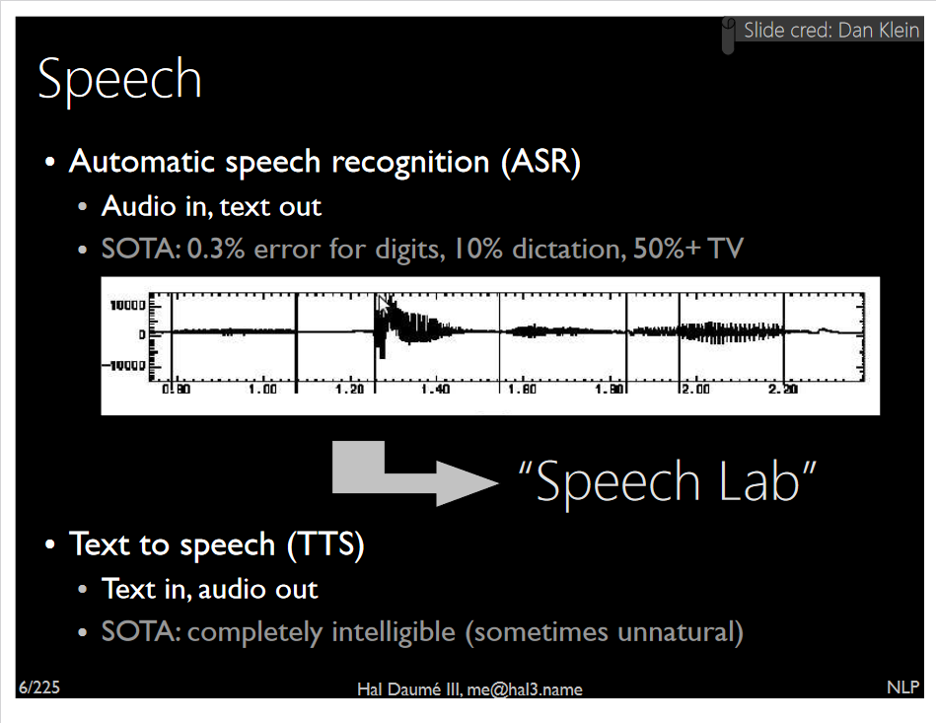
More on Automated Speech Recognition
Image from https://users.umiacs.umd.edu/~hal/tmp/mlss.pdf

Slide 18
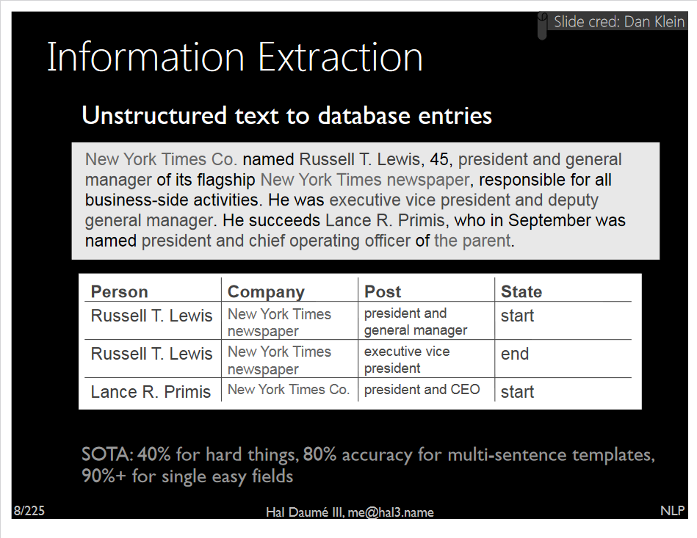
More on Information Extraction
Image from https://users.umiacs.umd.edu/~hal/tmp/mlss.pdf

Slide 19
More on Automatic Text Generation
You may have heard of GPT-2 and/or GPT-3
Trained on 40GB of Internet text to simply “predict the next word”
Trained on 8M webpages
Try it out yourself!
https://transformer.huggingface.co/

Slide 20
More on classification and/or regression
You can train a model to classify or perform regression on sentences
For example, sentiment analysis already does this

Slide 21
Next class: Natural Language Processing
HW8 is optional extra credit (next slide)
Added points to your total homework points
Project 2 due 4/05
CNN classification on Stanford Dogs dataset
Individual work
Submit on BB
Group project check-in due 4/07
submit on BB using “Project 2 link”

Slide 22

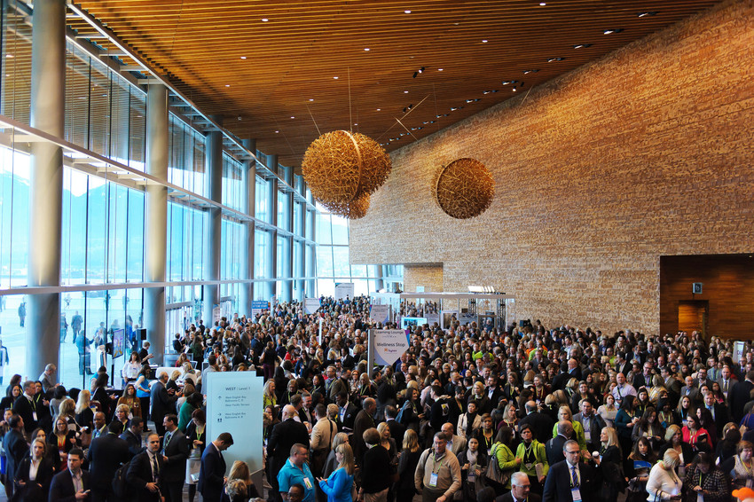
Homework 8 [extra credit]: In class exercise: groups of 2-3 students
Let’s discover the topics in academic conference papers from NeurIPS
Using gensim, a popular NLP library
This is NOT deep learning today
Let’s walk through this tutorial together: https://radimrehurek.com/gensim/auto_examples/tutorials/run_lda.html
When finished, write a paragraph on what you would do next with this dataset/problem
Submit your code on BB

